Slide 1
Introduction to MLOps: Versioning, Automation, and Collaboration
Harsh Dalal

Slide 2
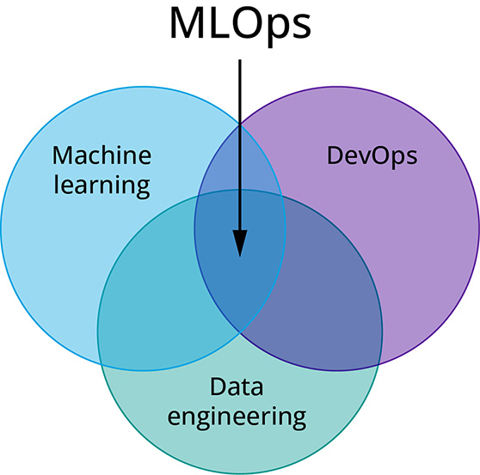
What is MLOps?
MLOps (Machine Learning Operations) is a set of practices that aims to deploy and maintain machine learning models in production reliably and efficiently.
Key Objectives:
Automate ML workflows
Improve collaboration between teams
Ensure reproducibility and scalability

Slide 3
Why is MLOps Important?
ML systems are more complex than traditional software
Frequent changes in data, code, and models
Need for collaboration across data scientists, ML engineers, and ops teams
Improves model reproducibility, reliability, and faster deployment

Slide 4
Key Pillars of MLOps
1. Versioning
Ensures traceability and reproducibility across the ML lifecycle.
What to Version:
Data: Raw and processed datasets, training/validation splits
Code: Model architecture, feature engineering scripts, evaluation metrics
Models: Trained model binaries, hyperparameters, metrics
Experiments: Run metadata, parameters, outputs
Best Practices:
Use Git for code versioning
Use DVC (Data Version Control) or LakeFS for large dataset tracking
Use MLflow / Weights & Biases for model and experiment versioning
Benefits:
Easy rollback to previous states
Enables collaborative experimentation
Ensures reproducibility of results

Slide 5
2. Automation
Automates the end-to-end ML workflow to ensure speed and consistency.
Where to Automate:
Data Ingestion & Preprocessing
Model Training & Tuning
Validation & Testing
Deployment (CI/CD)
Monitoring & Retraining
Tools & Frameworks:
Airflow / Prefect – Workflow orchestration
Kubeflow Pipelines – ML workflows on Kubernetes
GitHub Actions / Jenkins – CI/CD pipelines
SageMaker Pipelines – End-to-end automation on AWS
Benefits:
Reduces manual errors
Enables repeatable and scalable processes
Speeds up development and deployment cycles

Slide 6
3. Collaboration
Bridges the gap between cross-functional teams involved in ML projects.
Involved Teams:
Data Scientists – Focus on models and data exploration
ML Engineers – Optimize models, productionize code
DevOps Engineers – Handle infrastructure, deployment, monitoring
Business Stakeholders – Define objectives, review outcomes
Collaboration Strategies:
Shared project repositories (e.g., GitHub, GitLab)
Common tooling (Docker, virtual environments)
Centralized documentation (e.g., Notion, Confluence)
Experiment dashboards (e.g., Weights & Biases, MLflow)
Benefits:
Reduces siloed workflows
Improves transparency and accountability
Speeds up feedback and iteration cycles

Slide 7
MLOps Lifecycle Overview
Data Collection & Versioning
Model Development
Experiment Tracking
Model Deployment
Monitoring & Feedback

Slide 8
Benefits of MLOps
✅ Faster Model Deployment ✅ Improved Reproducibility ✅ Scalable & Automated Workflows ✅ Better Collaboration Across Teams ✅ Continuous Monitoring and Improvement

Slide 9
Challenges in MLOps
⚠ Complex Infrastructure Setup ⚠ Data/Model/Code Drift Over Time ⚠ Lack of Standardization ⚠ Resistance to DevOps Culture in ML Teams

Slide 10
Summary & Takeaway
MLOps bridges the gap between ML development and production
Focuses on versioning, automation, and collaboration
Helps in reliable, scalable, and maintainable ML systems

Slide 11
MLflow: Experiment Tracking and Model Registry
Harsh Dalal

Slide 12
What is MLflow?
Open-source platform by Databricks
Designed to manage the ML lifecycle
Language & framework agnostic
Works with any ML library (e.g., scikit-learn, TensorFlow, PyTorch)
Core Idea: Reproducibility, Traceability, and Deployment of ML models.

Slide 13
ML Lifecycle Challenges
Managing different code versions
Comparing multiple model runs
Tracking metrics & parameters
Reproducing past results
Versioning and deploying models

Slide 14
MLflow Components
Tracking: Logging experiments (parameters, metrics, artifacts)
Projects: Packaging code in a reusable format
Models: Standard format to package models for deployment
Model Registry: Centralized model store with versioning

Slide 15
MLflow Tracking: Key Features
Log parameters, metrics, artifacts, and source code
Supports local and remote tracking servers
UI for comparing runs
Auto-logging with frameworks (e.g., mlflow.sklearn.autolog())

Slide 16
MLflow Model Registry Overview
Centralized model store
Tracks model versions, stage transitions, and metadata
Supports stages: Staging, Production, Archived
Enables CI/CD and A/B testing workflows

Slide 17
Model Registry Features
Register and version models
Add/modify stage transitions
Commenting & annotations
Integration with deployment tools

Slide 18
MLflow Use Case: End-to-End Flow
Train a model and log with MLflow
Compare experiments via MLflow UI
Register the best model
Transition model to Production
Deploy using REST API or integration (Flask, FastAPI, etc.)

Slide 19
Hands-on: Example Workflow (Overview)
Dataset: Wine Quality Dataset
Model: Decision Tree Regressor
Logged Parameters: Max_depth, Min_samples_split
Metrics: MAE, RMSE
Tools: Jupyter Notebook + MLflow + Local UI

Slide 20
Summary
MLflow simplifies the ML workflow
Combines experiment tracking, model packaging, and deployment
Model Registry ensures production-ready model governance
Open-source, extensible, and integrates well with major tools

